Slide 1
ENSE 374, Milestone 5
The Great Value
Azeezat, Krupal, Joseph, Clark, Martha
December 6, 2018

Slide 2
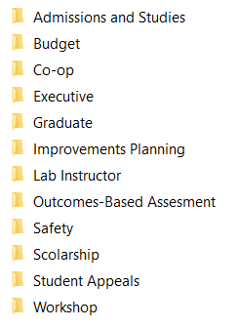
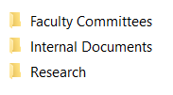


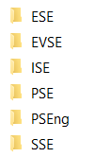


Content Strategy
First level.
Second level.
Research
Second level.
Internal Documents
Second level.
Faculty Committees
Third level.
Forms
Third level.
Course Materials
Third level.
Faculty Committees

Slide 3
Usability Evaluation Results
 | Meigen (8/10) | Robyn (9/10)
Pre-task | Expectations Easy to navigate Intuitive Few clicks and tabs First impression Clean Menu is not huge | Expectations Simplicity Easy to find documents, committees, as well as explain to others how to find First impression Simple Clean
Task | Tasks were found easy to complete | Tasks were found easy to complete
Post-task | Missing Policy Procedure (documents) External Links ( Personal Safety ( Terms & Reference (documents) | Missing Events (homepage) Policies (documents)

Slide 4
DEMO

Slide 5
Discussion of next step
Gaps in Proposal
Removed the side navigation due to its complexity.
We did not implement the login page so we couldn’t test the privacy of folders.
We implemented a dropdown in our main navigation bar.
Hurdles in Implementation
The login page and privacy of folders will be highly dependent on IT security controls.
Easy to use for the user who doesn’t know how to code, however, there are a lot of folders and it may be difficult to keep track of when creating new pages.

Slide 6

Group Reflection
About this project:
We had a lot of fun throughout the process of designing the website. When we got the hang of using Github as well as Cascade and its many limitations, we had to change our method to find one that works for us. When we did, everything went by fast.
About ourselves:
We realized we will really miss the harmony and amiability we have achieved as a group. Every milestone of this project has been amazing, and we were able to make time to meet up, even with our busy schedules.
In the future:
We will use the skills we acquired doing this project in future classes. We learned a lot about group work and cooperation, as well as delegation.
Additional clarity?
Nope. Everything was clear.
Image taken from: http://homeschoolcpa.com/board-turnover-may-mean-the-purpose-of-the-homeschool-group-could-change/
Notes:
How did you feel about this milestone? What did you like about it? What did you dislike?
What did you learn about yourselves as you collaborated and worked through this milestone?
How will you use what you have learned going forward?
What “stuff & things” related to this milestone would you want help with?

Slide 7
Questions?
¡Gracias!

